Slide 1
Portfolio material proposal
August 14th, 2018 | Melody Ting

Slide 2
Proposed presentation format
Projects would be password-protected on my personal website (melodyting.com)
Each project would be given its own page and consequently password

Slide 3
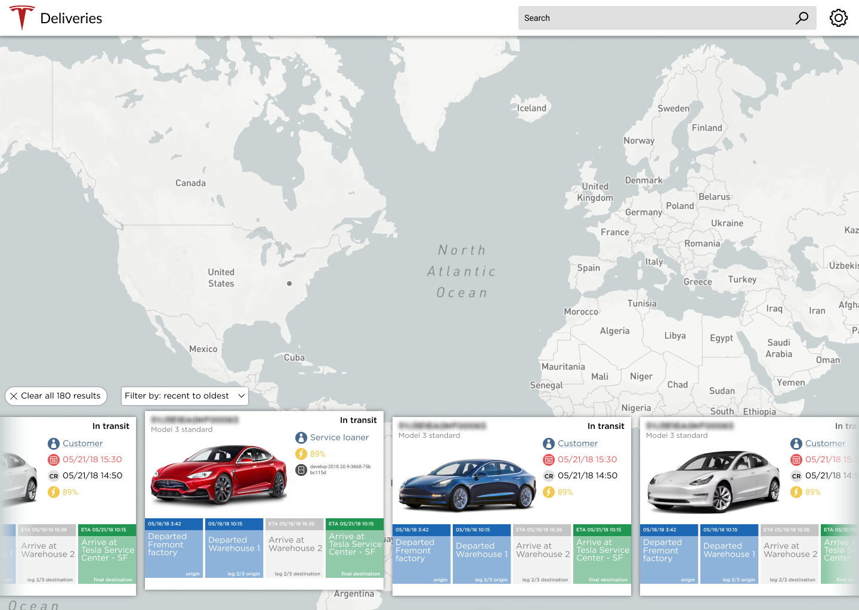
Finished vehicles map concept pt.1

Slide 4
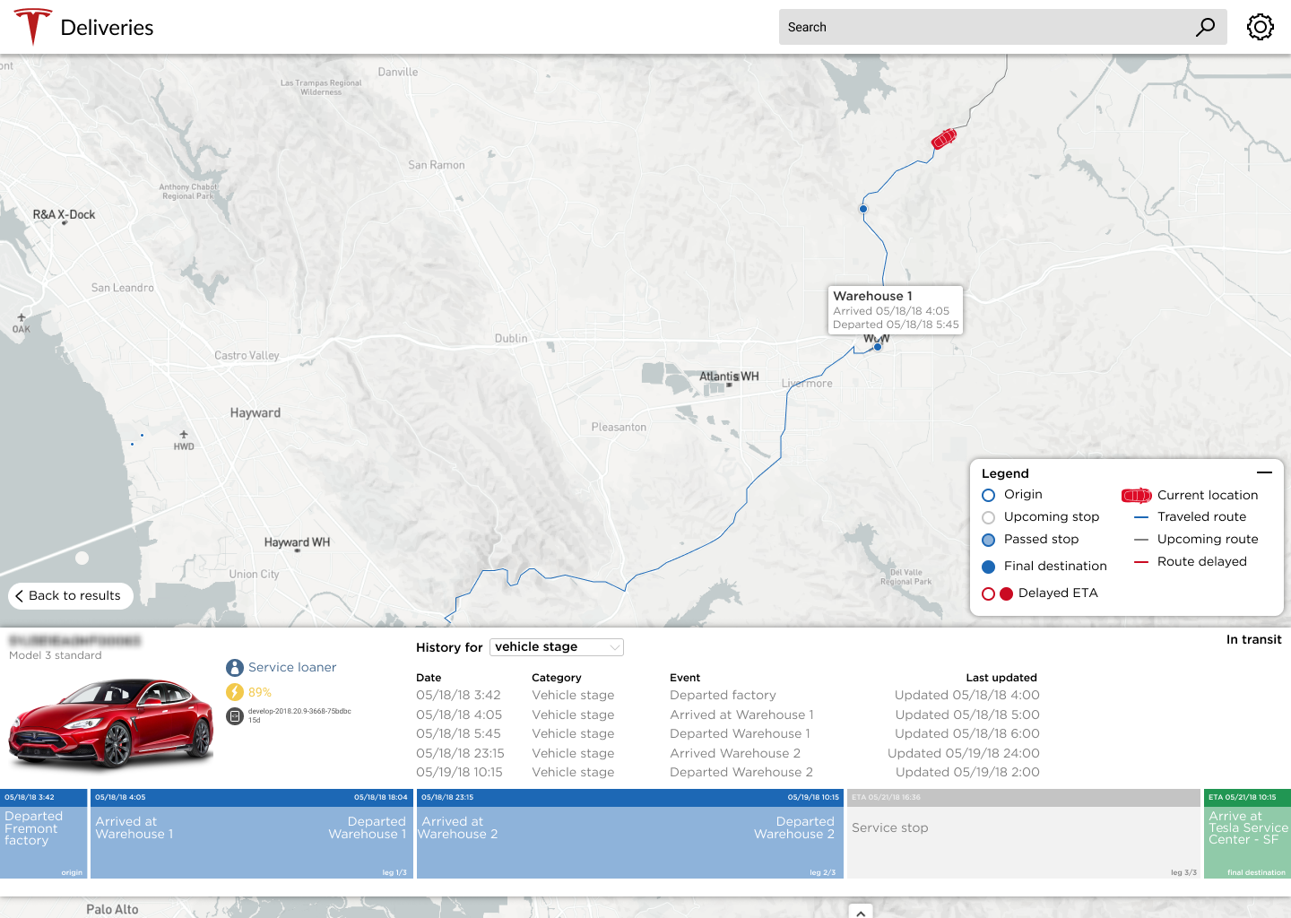
Finished vehicles concept pt.2

Slide 5
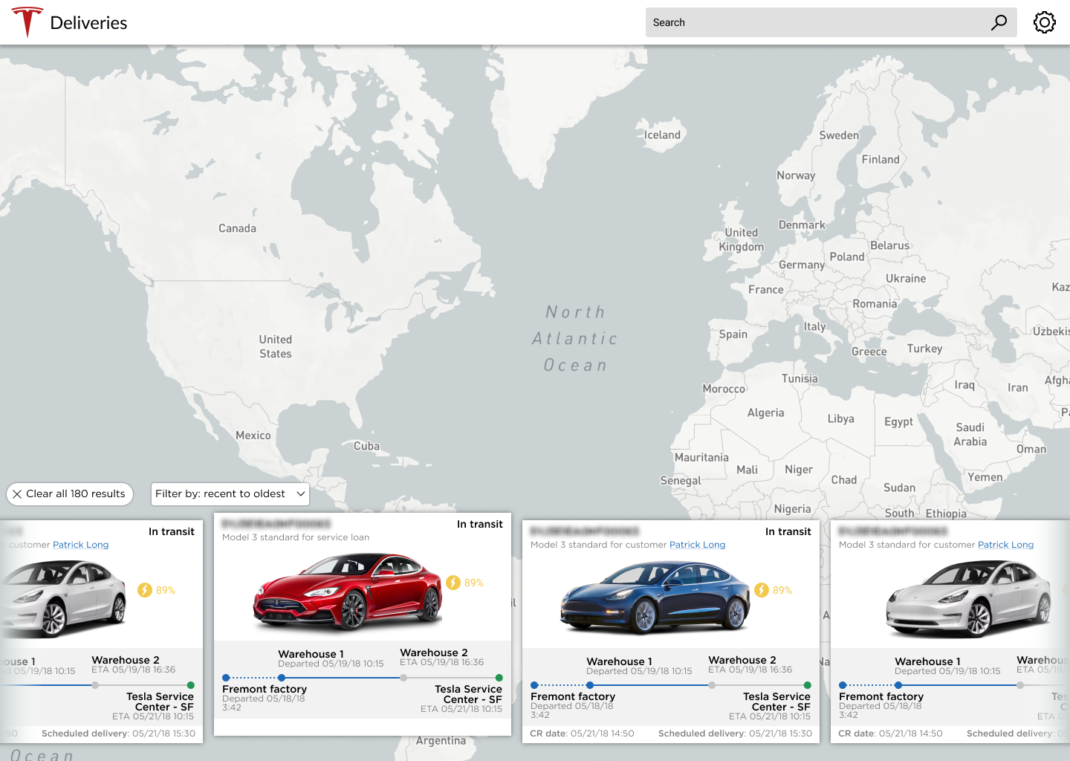
Finished vehicles concept pt .3

Slide 6
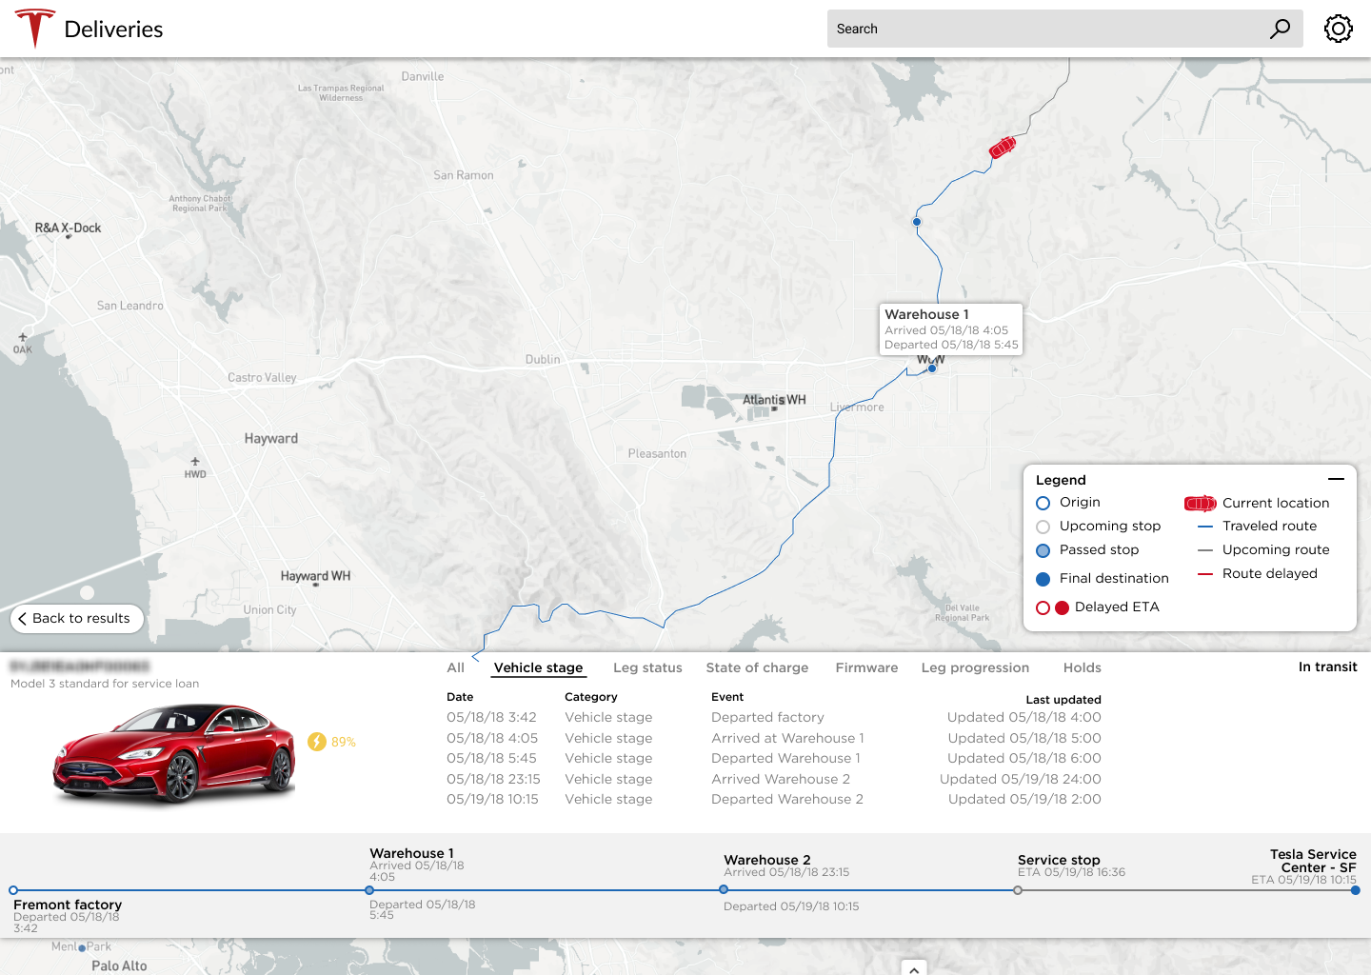
Finished vehicles concept pt.4

Slide 7
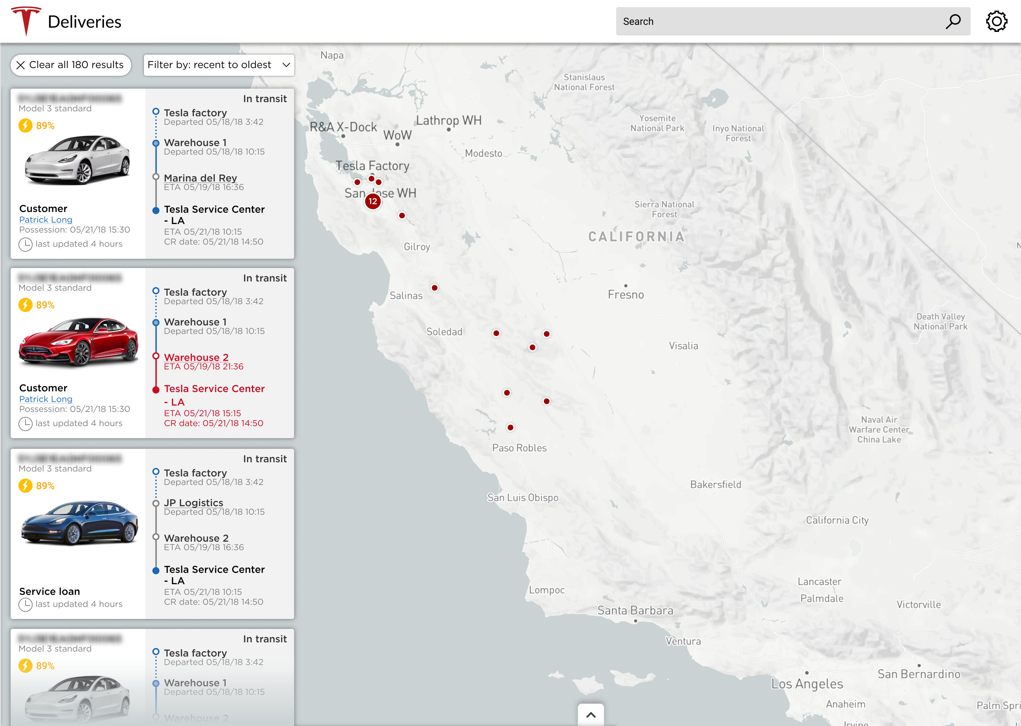
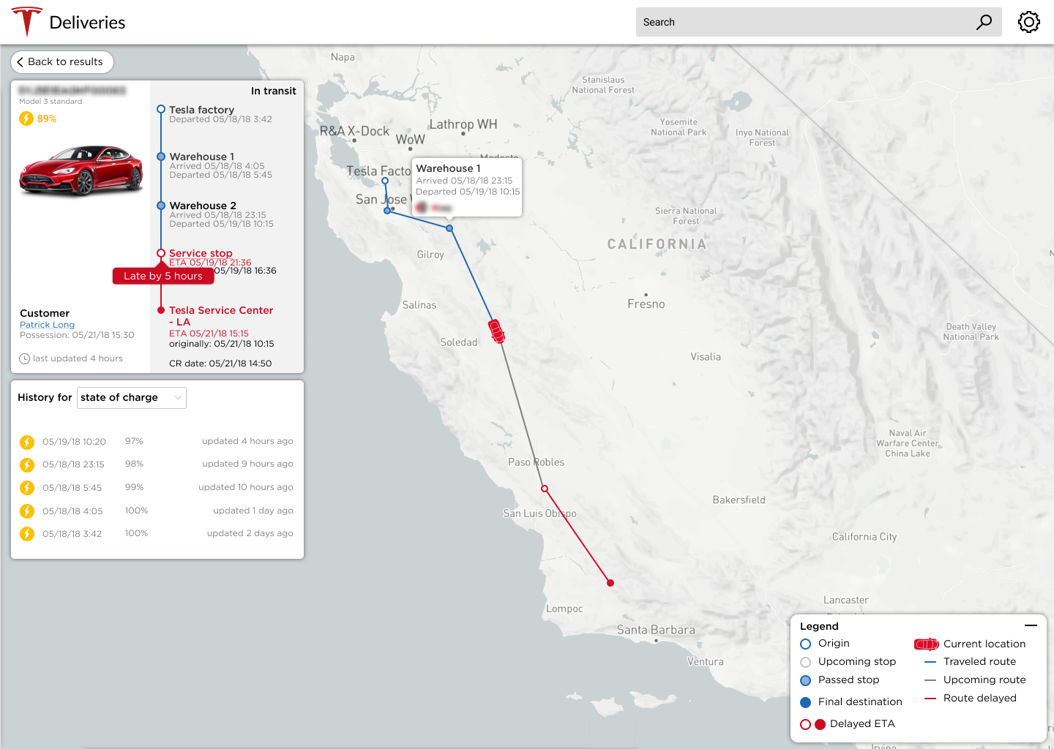
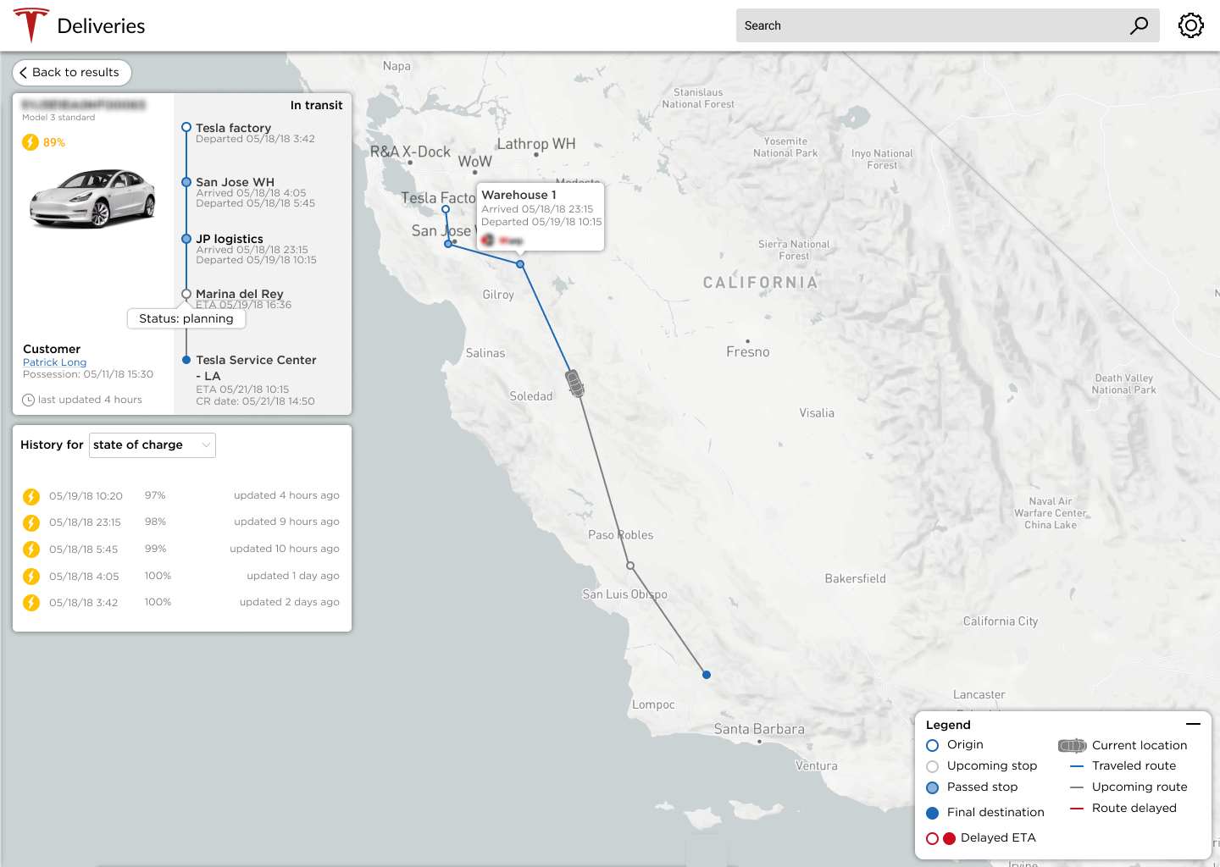
Finished vehicles map concept pt.2

